Slide 1


Application of Simulation Algorithms in Parkinson Disease
Team Members:
Andrea Policano
Huyen Pham
Notes:
Good morning everyone, today me and Huyen will be presenting our project related to the applications of mathematical modelling and simulation algorithms in the context of pharmacodynamics studies for the parkinson disease, we would like to start off with a presentation of the disorder itself

Slide 2

Introduction
Dealing with Parkinson’s Disease
Affecting dopaminergic neurons in substantia nigra
Impairment of normal motor-associated functions of the patient
10 million world-wide, usual starting point at 60
No definitive treatment
Notes:
As we already know, it is a neurodegenerative disorder that affects the brain, targeting mainly the dopaminergic neurons located in the substantia nigra, its effect mainly consists in the disruption of the normal motor functions, such as tremors, slow movements, rigid muscles, loss of voluntary movements changes in writing and speech, in addition to that nausea and confusion may also be seen. At the moment at least 10 million…. At the moment there is no definitive treatment, except…

Slide 3
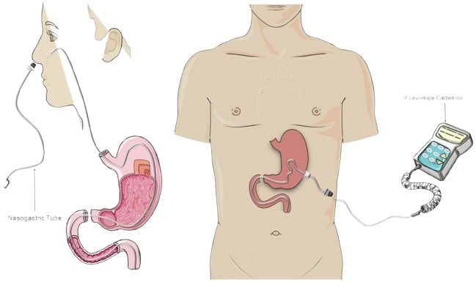
Levodopa treatment
Golden standard for Parkinson’s
Used in combination with Carbidopa
Challenging pharmacokinetics
Taken and monitored in many ways
Maccarrone et al. (2024)
Notes:
Levodopa, as of today, represents the gold standard for parkinson treatment, it essentially helps in the re-intake of the dopamine in the brain, it can be used in combination with carbidopa to ease the transport into the brain. the drug can be absorbed either by infusion or orally and its concentration can be measured in multiple ways, one of those can be seen from the image. The main problems with this treatment lie in the difficult pharmacokinetics behind the drug itself, due to its short half-life it cannot stay constant for a long time in the bloodstream, and that is crucial point that needs to be solved. The paper we are going to present today, written by Murshid et al. is focused on the of past literature and the implementation of a stochastic differential equation approach to produce a model able to fit much better the available data on Levodopa concentration.

Slide 4

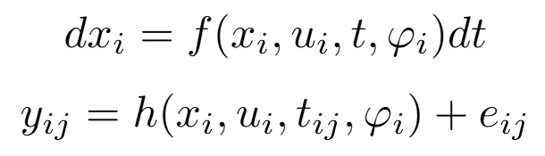
The paper
Representation of the pharmacokinetics…
Notes:
In the paper the pharmacodynamics data are characterised by non-linear mixed effects having the general structure, where we can see a vector of measurements ni, per patient N at time tij. In here we have a distinction between intra- and inter-individual variability , the latter introduced as this: …
x(i) state at time ti (represents the concentration at that time)
ui vector of optional inputs
t/tij jth time measurement
phi vector for each that captures inter-individual variability and has population level fixed effects and individual-specific random effects
eij is the measurement error with normal distributions
In this paper the study is conducted on a 2-compartment model, from which 2 models are derived

Slide 5
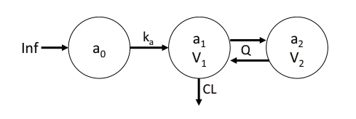
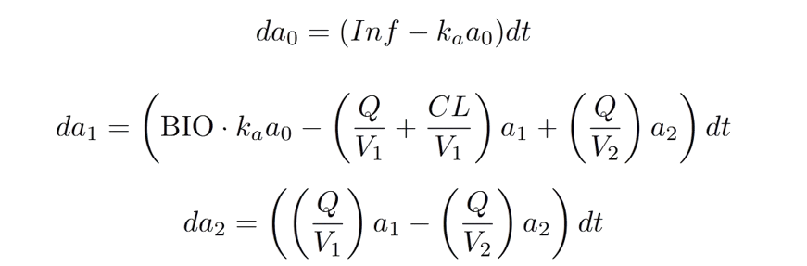
The ODE model
ODE Model
Notes:
One of the two models present in this study is the ODE, developed from Westin et al. characterise the passage of the drug through the considere compartments, the first one represents the movement of the drug from the peripheral sections into the central compartment, the second one comprise the movement that the drug can take in the central compartment, considering also those coming from the adjacent sectors, and the final one represents the movement coming from the second compartment.
From this schema, Murshid et al. wanted to better fit the data and better capture biological fluctuations characteristics of the biological world, doing so by accountin for stochasticity

Slide 6
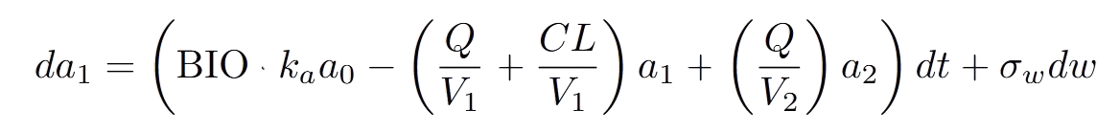
The SDE model
SDE Model
system noise
Notes:
The SDE model is the result of the implementation of stochasticity in the ODE model, an addition that was not present before, and original of Murshid et al., is the presence of the system noise, which allows for random variations and offers much more flexibility of the model thanks to the incorporation of the error, it accounts for auto-correlated individuals and can also be used in residual error modelling.

Slide 7
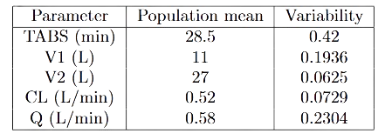
Fixed parameters
Values obtained from previous studies and used to fix the parameters

Slide 8
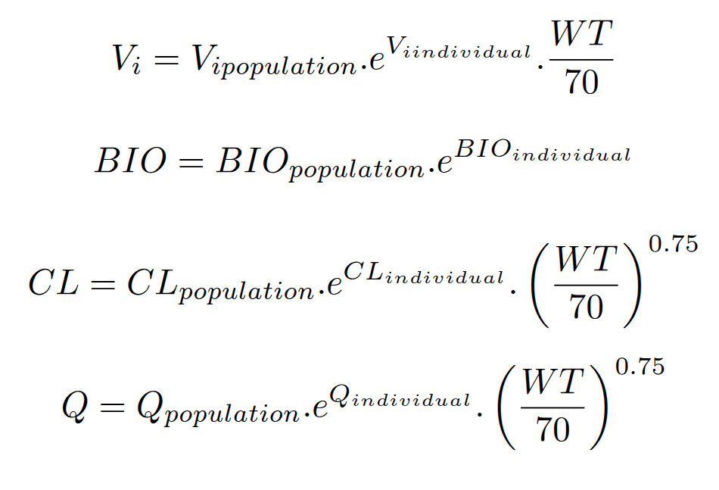
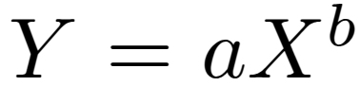
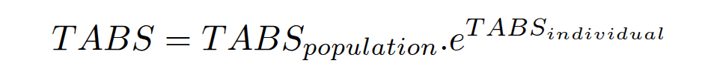
Individual random effects
Theory based allometry
(Body size affect traits)
Y: trait
X: size variable in this case is the weight
b: scaling factor
Notes:
In addition to the parameter we need also to account for individual random effects. This is according to theory based allometry that the body size will have some effects on the phenotypic traits. In the case of levodopa pharmacokinetic, body size refers to person weight and the traits is some of our parameters that will vary due to weight. We have Y = aX^b, apply the theory, we need to scale V, Cl and Q because volume, clearance and distribution of the drug over the body can be influenced by patients weight while in the case of BIO and TABS, we do not have to scale because it related to absorption through the intestine to enter the circulation system so the absorption is not affected by patient weigth.

Slide 9
Parameter estimation
Step 1:
Setting:
Measurement noise to 1
σ to 0 in ODE and from 0.1 to 1 in SDE
Estimate bioavailability
Step 2:
Variability in bioavailability is low -> fix to 0
Estimate bioavailability and system noise σ
Notes:
Then we have 2 main steps for parameter estimation, in the first step the setting is that measurement noise is set to 1 and system noise is set to 0 in ODE, 0.1 to 1 in SDE model. Then bioavailability is estimated using MLE
then in the second step variability in bioavailability is set to 0 because it was found to be low in the first step, then bioavailability and system noise is estimated by MLE

Slide 10
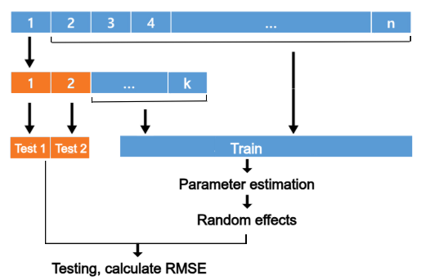
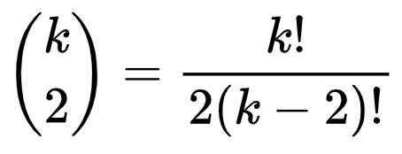
Cross validation
Repeat by:
Within patient: selecting different occasion number for testing. Number of combinations is
Iterate over number of patients
Cross validation
Notes:
In the cross validation procedure, 2 occasions (ie experimental time points) are selected from a patient to be 2 test sets, the remaining occasions of that patient and the remaining patients with all the occasions are in training. For the train set, the parameter is estimated follow the steps described previously and account for individual random effects are also calculated based on the formula. After that those parameters are apply to the test set and RMSE is calculated between the result of testing and smooth estimated at time t. Then repeat by select different occasion within the same patient the number of combination should be select 2 over k occasions. Iterate over different patients and continue to select occasions.

Slide 11
Limitations
Small dataset
(8 patients, 20 occasions)
Maximum likelihood estimation (MLE) is biased
for small dataset
Fixed parameters
(previously estimated in small datasets too)
Accuracy concern
Notes:
Limitation of the study lying on small dataset that is collected from 2 other previous studies, in total 8 patients and 20 occasions but not for each patients, occasions is based on the time points. study 1 has 5 occasions and 2 has 15 so total 20. As we have limit amount of data MLE can give bias results. therefore to improve this we need either to generate data ourselves or collected more data available from other studies. unfortunately, this may be hard too cause they require contact with author or having some restriction in license.
The model use fixed parameters coming from previous study that has small dataset too, so once we generate or gather enough data, we should reestimate those parameters too.

Slide 12
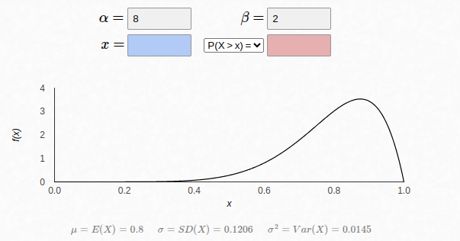



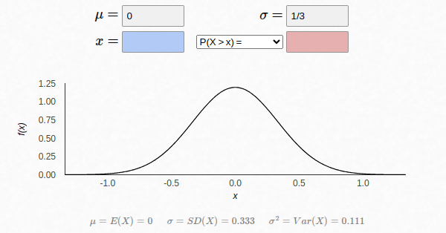


Bayesian estimation
Notes:
Since MLE may not be a well approach for a small dataset. We recommend bayesian estimation. From the study, MLE estimate BIO around 75-76% and from previous study at 0.88 so we can expect the mean is around 80. So we expect it has beta distribution. Since we not not know the height of the distribution, we can decide alpha + beta to range from 10 to 100 for exploration between average/strong prior and very strong prior. variability in Bio stating from the paper is low, but we do not trust because one found at 75% and another paper found at 80%. For the system noise, we expect it to range from 0 to 1 with the noise is small, coming from the result of MLE estimation at 0.099. So it is half normal. We have normal distribution X ~ Normal with mean 0, we want it to be between -1 and 1 so based on the 99.7% rules we got mu-3sigma_n = -1 and we got sigma_n=⅓.

Slide 13
Metropolis Hasting
Initial point: Bio at 0.8 and system noise at 0.1
Proposal distribution: normal
Sample new point
Compute acceptance probability
Iterate to get more samples
Trace plot
Notes:
After setting the prior distribution, we can compute the likelihood function and the posterior probability distribution. Then perform sampling using metropolis hasting algorithm. We can select the initial point for BIO at 0.8 and system noise at 0.1, proposal distribution is normal distribution. After sample a new point from the distribution, we compute the acceptance probability by taking P(bio’, sigma’|data)/ P(bio, sigma|data). then we can draw a random number between 0 and 1 from uniform distribution if r<min(1, P(bio’, sigma’|data)/ P(bio, sigma|data)) then accept and assign bio and sigma to the new one otherwise reject. Keep iterate to get more samples and then we can plot it in trace plot to see if it convergence.

Slide 14
Gradient-Based Methods
Algorithms for optimizing a function by finding where gradient reaches zero, or falls over a threshold…
Taylor theorem
Converge quickly
Heavy at each iteration
Notes:
Gradient-based algorithms aim to minimize an objective function by using the approximation of the gradient computation, derived from the implementation of the Taylor theorem on point-wise defined function, they are heavy at each iteration since they require to evaluate the function multiple times but require few iterations to converge, or fall over a certain threshold that we set.

Slide 15
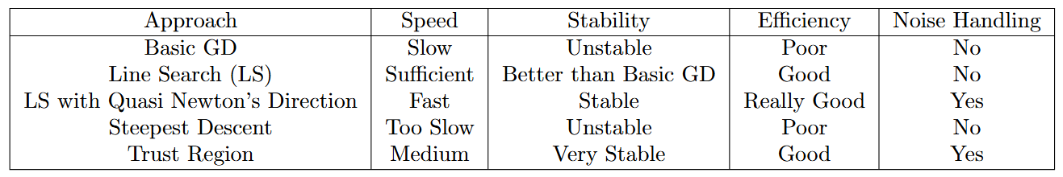
Gradient-Based Methods
Giving a general idea about them…

Slide 16
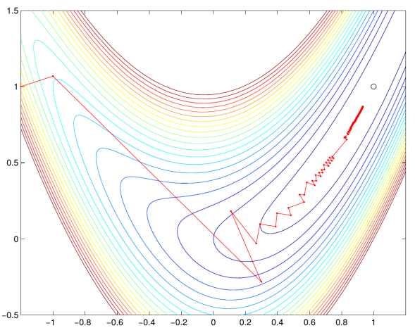



Line Search with Quasi-Newton’s Direction
From the theory…
https://wiki.mcs.anl.gov/leyffer/images/4/47/04-newton.pdf
Notes:
find the direction that minimizes the objective function of interest
We apply Taylor theorem and after a series of transformation and setting the derivatives to 0 we obtain the formula to find the direction, which, in a multivariate context we can read as:
talk about the second formula
Hessian matrix approximation to reduce computational costs

Slide 17


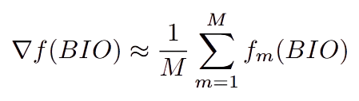


Line Search with Quasi-Newton’s Direction
To the practice…
1.
4.
2.
5.
6.
3.
Notes:
Objective function using the residuals between predicted and experimental data
Use of Monte Carlo averaging to account for possible stochasticity interference
Calculation of the gradient or alternatively use finite differences method, if normal normal way too slow
Update of Bio parameter using the new information and Hessian approximation
Check the formula to obtain alpha
Check formula to obtain the distance

Slide 18
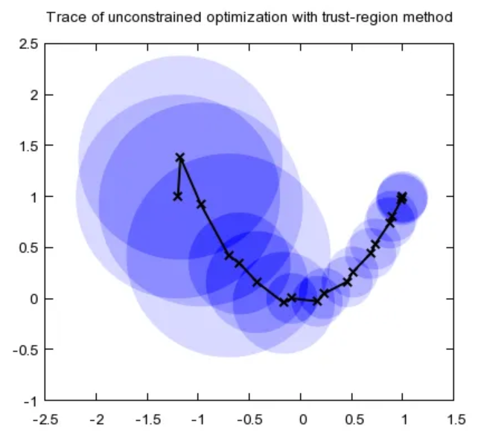








Trust region
From the theory…
https://medium.com/intro-to-artificial-intelligence/line-search-and-trust-region-optimisation-strategies-638a4a7490ca
Notes:
In this case we try to solve a subproblem which represents the quadratic approximation for the original problem that we want to solve (objective function)
Inserting a trust region parameter as we are not anymore governed by the step length, substitution of p with trust region as it symbolizes the maximum extent of p
Insertion of new parameters and conditions leads to the fourth formula
Resulting direction after a series of transformation

Slide 19

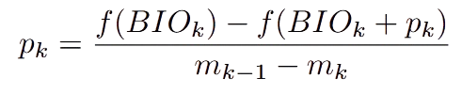





Trust region
To the practice…
1.
5.
2.
3.
4.

Slide 20
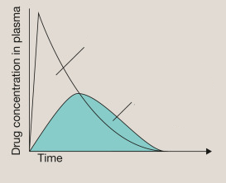

Bioavailability estimation evaluation
AUC intravenous
Robertson’s study:
AUC intravenous is 2121±230 ng.h/mL
Levodopa dose is 50mg
Patient age: 60-70
AUC case
Notes:
We recommend to compare bioavailability estimated by the model vs bioavailability calculated by the formula. Bioavailability is the fraction of the drug enter the circulation, so in the intravenous-inject through the vein, levodopa directly enter the blood circulation. Therefore bioavailability is 100% in this case. To calculate bioavailability, we can take the area under the curve of the plot levodopa concentration in plasma in time under the case of interest divided by the AUC in the intravenous case. If the 2 are different doses, we can multiply by dose intravenous/dose case. In the most accurately way, we need to generate the data that have information on both the case of interest and intravenous on the same patient for bioavailability but often, we do not have this information available in hand because we also collect available data from other studies. In this case, we can find the study on also intravenous case to take average AUC intravenous to compute bioavailability. After that, we can compare the result we got from the model vs the result from the formula. In this way, we can evaluate the result we got from the model. If we do not have AUC provided in the study, we can try to plot if we have enough data point and try to detect the function of the curve where we can integrate to get the area.

Slide 21
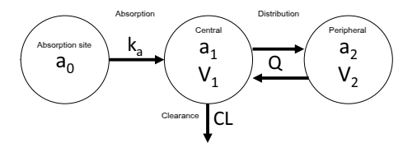
Extension:
Model on different administration/levodopa formula
Why?
To know the behavior of different administration types to decide the dose
To better formulate levodopa
Administration types:
Inhale
Oral
Infusion
Notes:
Other possible extension is to study the model in different cases, this allow us to investigate different in bioavailability based on different administration types and with different formulation of levodopa because usually it does not taken alone but combine with others to improve effectiveness. Therefore, investigate in different case can help to better to decide the dose and strategies for the treatment. The general model is same as before, except that for different administration site, we have difference in absorption sites a0, it will be lung for inhale, intestine for oral and infusion, therefore will have different in absorption rate ka too. Depending on how the drug is release, we may have the rate toward the absorption site, for example infusion rate in infusion case. Then the model and computing should be quite similar

Slide 22
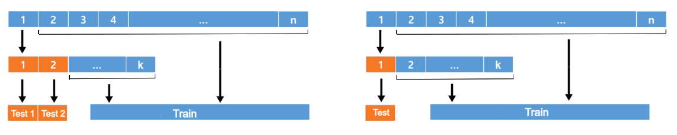
Extension: Leave one out cross validation
Cross validation from the paper
LOOCV
n patients
n patients
k occasions
k occasions
Create new train/test set by:
Swap and select different occasion for test sets
Iterate for different patients
Create new train/test set by:
Iterate over the occasion
Iterate over different patients
Notes:
This is not improvement but just for a pure curiosity, we want to compare the result coming from cross validation procedure from the paper vs LOOCV

Slide 23
Conclusion
Data is the main issue
Suggest for improvement focus mainly on parameter estimation
Bioavailability evaluation
Extension on different scenarios to gain more insight to levodopa absorption
Notes:
To conclude the limitation of the paper lying in data and parameter estimations, we recommend mainly the improvement on parameter estimation and optimization, with bayesian estimation for small dataset and gradient based for optimization. Additionally, it would be interesting to compare bioavailability calculate based on the formula and definition vs the result of the model. There are much more space to explore the project such as on different scenarios of different administrative sites, drug release method, and drug formulation. All of these can give much information on the biology behind and help in decide better therapy for PD treatment.

